Slide 1
About Github

Slide 2
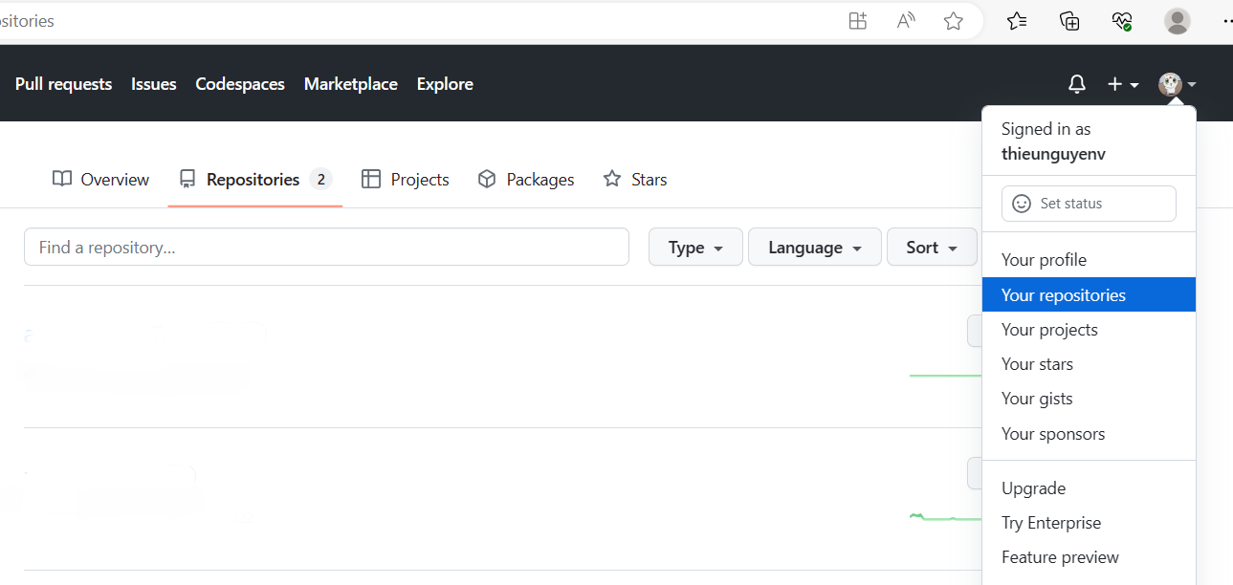
I. How to create repository name
Go to github.com
Click Profile -> click your repositories

Slide 3
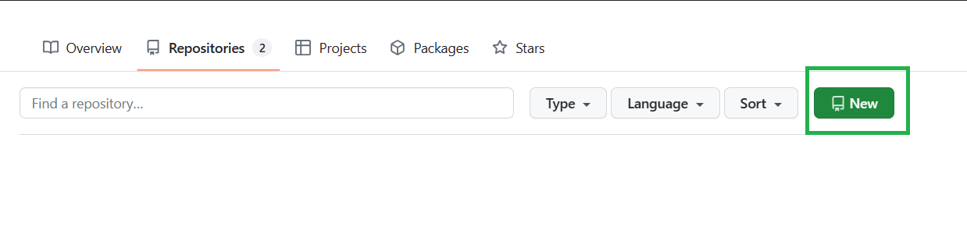
I. How to create repository name
Click ‘New’ create repository

Slide 4
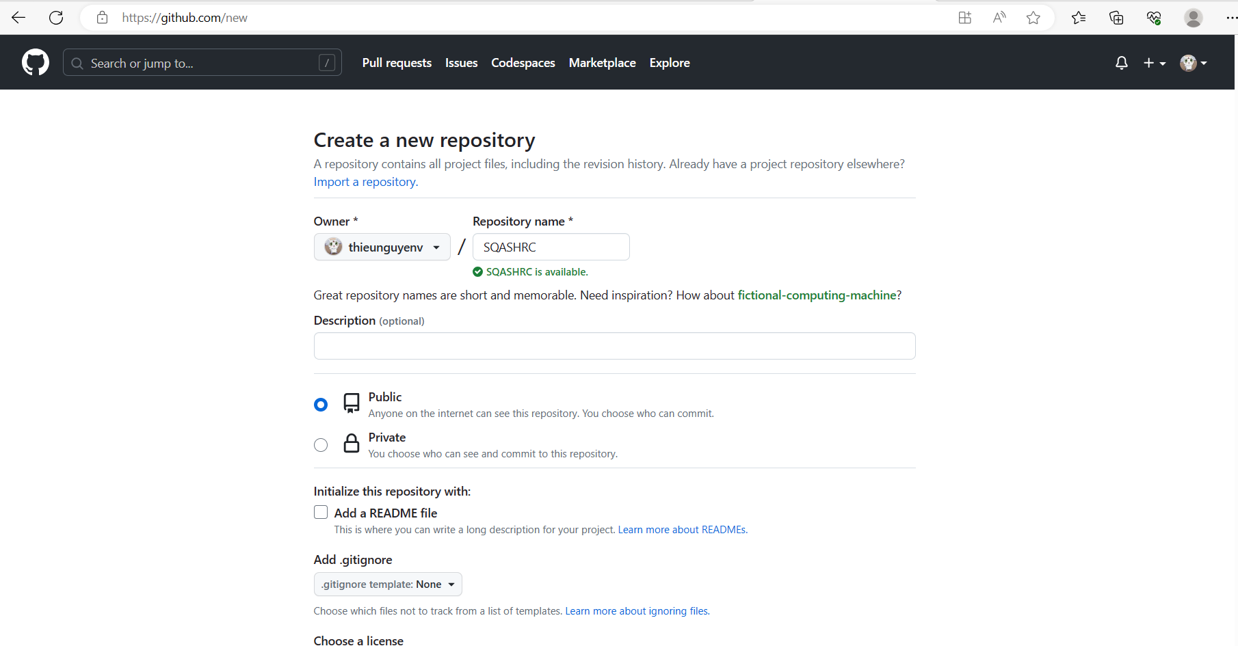
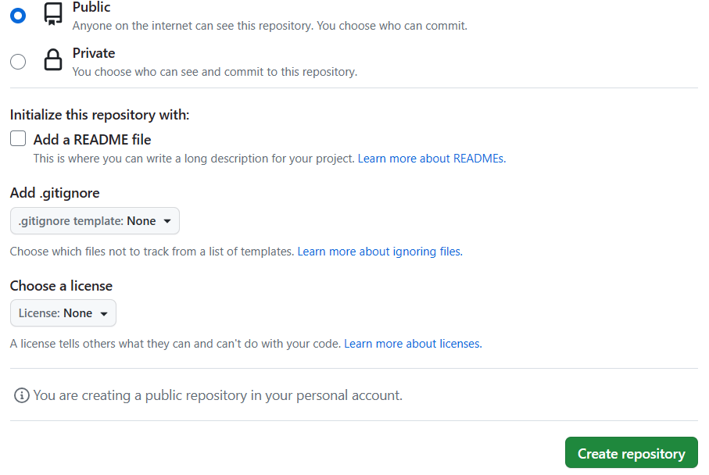
I. How to create repository name
Set project’s name
Set ‘public’ project
Click ‘Createrepository’

Slide 5
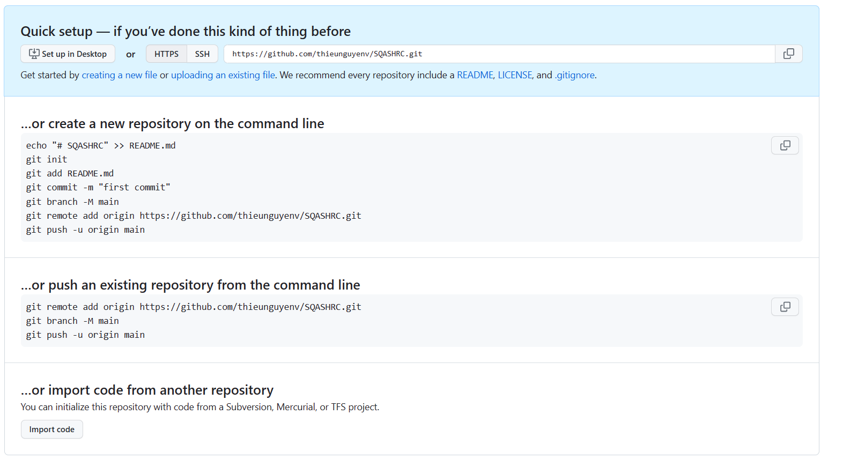
II. Create a new repository on the command line
Follow instruction

Slide 6
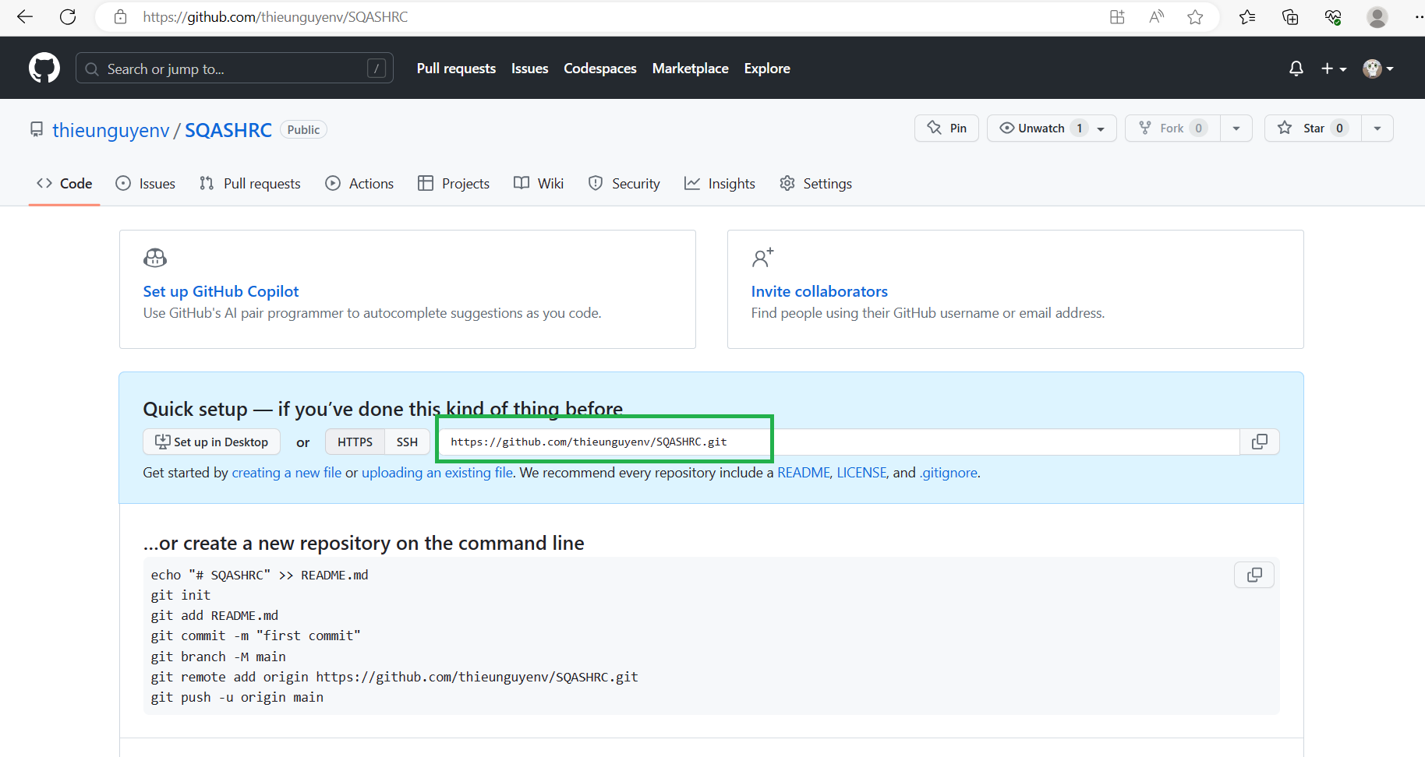
II. Create a new repository on the command line
Follow instruction
Detail:
Open Folder Where you want to set up project
Create file with name README.txt
Right click mouse and click ‘Git Bash Here’ and type this:
git init
git add README.txt
Git commit –m “Readme commit”
Git branch –M main
git remote add origin https://github.com/thieunguyenv/SQASHRC.git
git push -u origin main

Slide 7
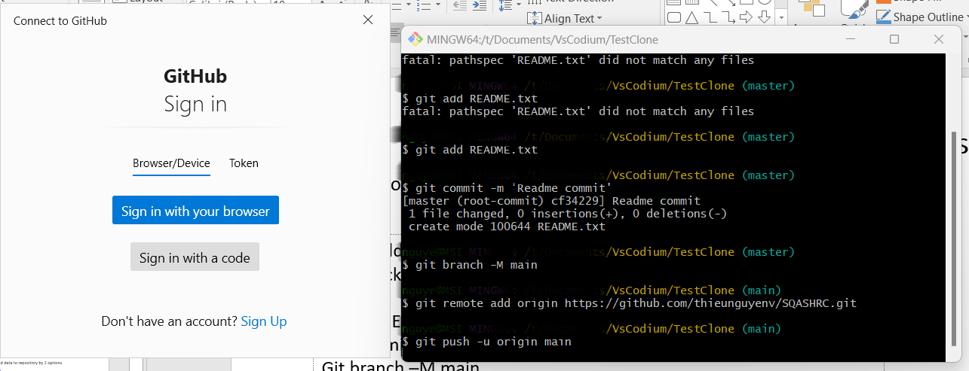
II. Create a new repository on the command line
Follow instruction
Detail:
After ‘git push -u origin main’ , will be ask login github
Sign in with your browser

Slide 8
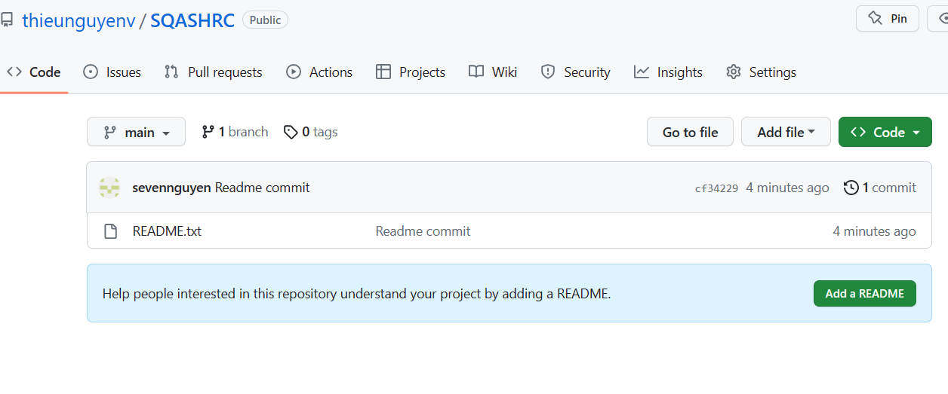
III. How to clone existing project
Follow instruction
Detail:
After Sign in with your browser check github browser

Slide 9
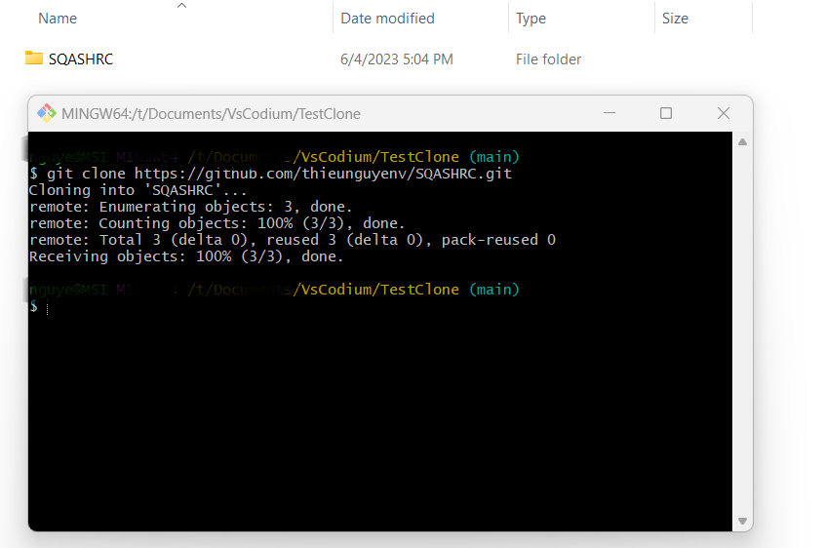
III. How to clone existing project
2. Clone project by ‘git clone url’
Detail:
Example : Already has project on github and just clone it
Right click mouse and click ‘Git Bash Here’ and type this:
git clone url
url is https you copied
Exp : https://github.com/thieunguyenv/SQASHRC.git
-> enter to clone project SQASHRC

Slide 10
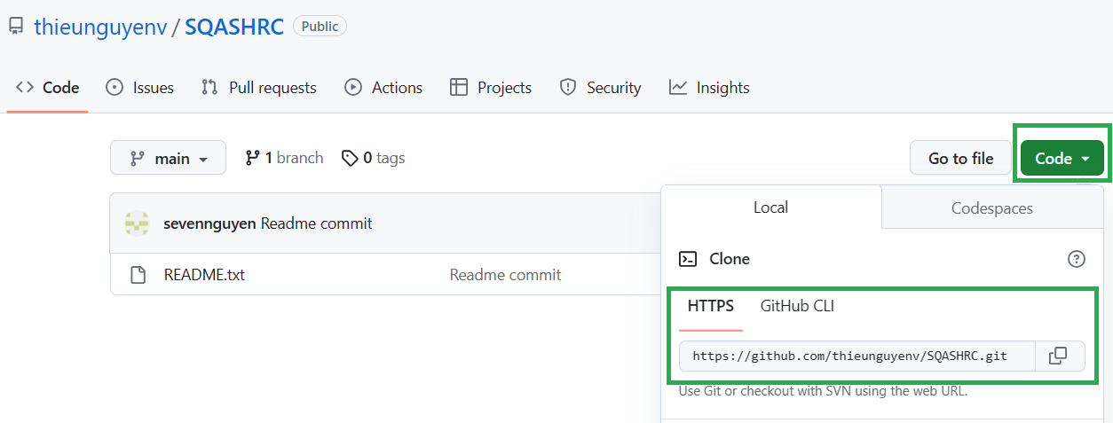
III. How to clone existing project
2. Clone project by ‘git clone url’
Detail:
Example : Already has project on github and just clone it
Right click mouse and click ‘Git Bash Here’ and type this:
git clone url
url is https you copied
Exp : https://github.com/thieunguyenv/SQASHRC.git
-> enter to clone project SQASHRC

Slide 11
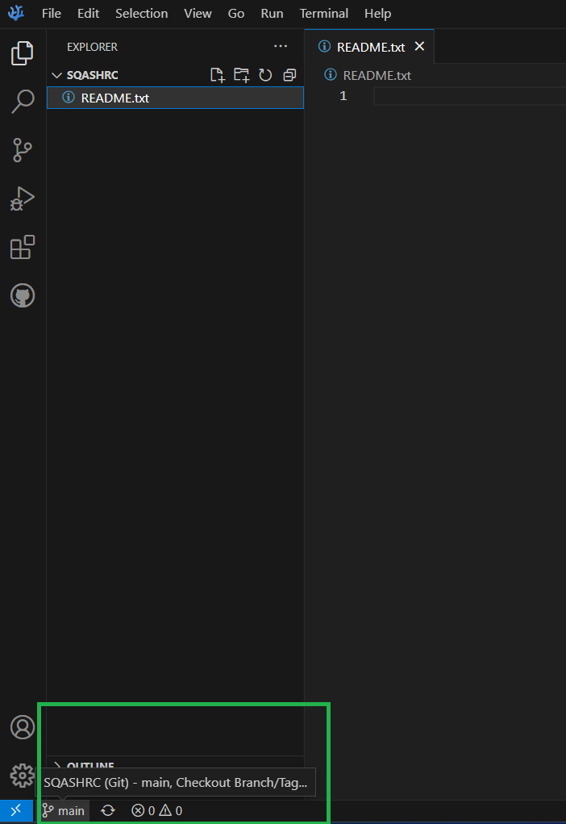
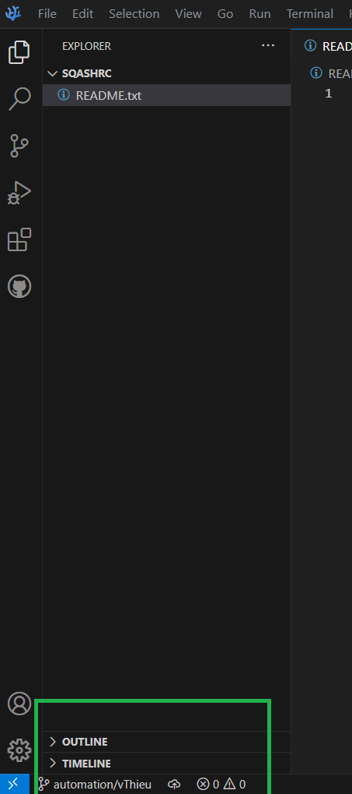
IV. Use VsCodium
Open VsCodium -> File -> open Folder where has project
After open folder
Create new branch – Do not edit on main branch

Slide 12
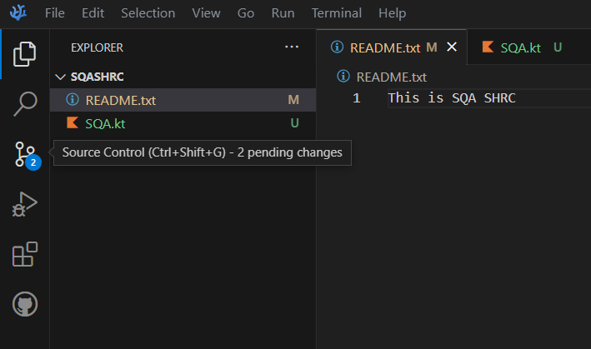
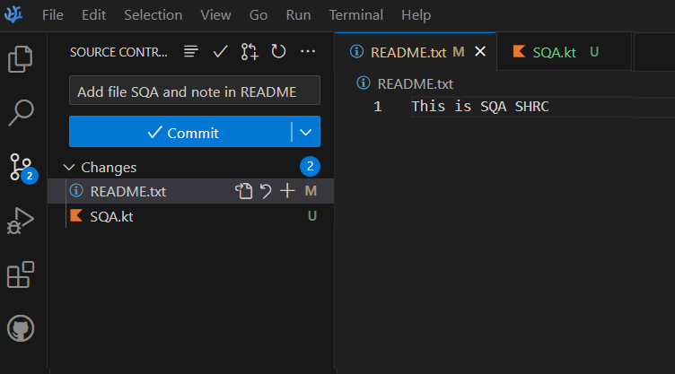
IV. Use VsCodium
Edit some file on new branch and save it
Click to Source Control to commit and push data to github project.
Fill the box with message that announce what file you changed then click commit.

Slide 13
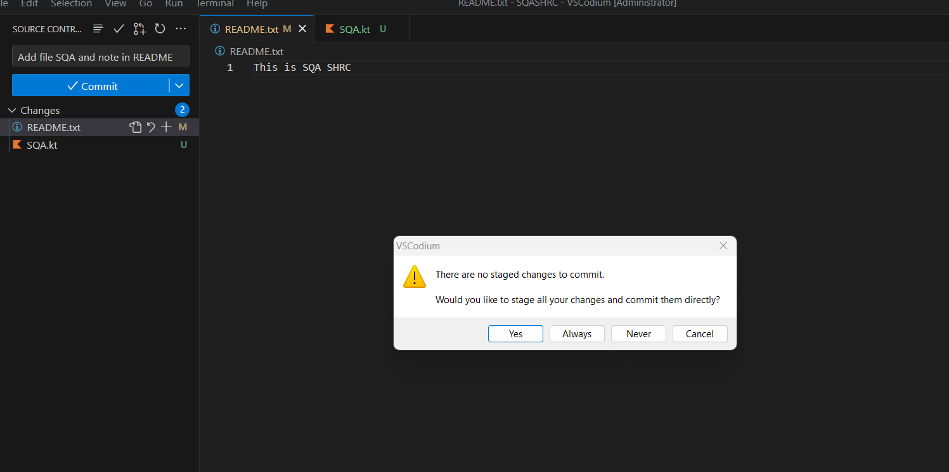
IV. Use VsCodium and Github
Fill the box with message that announce what file you changed then click commit.
Click Yes

Slide 14
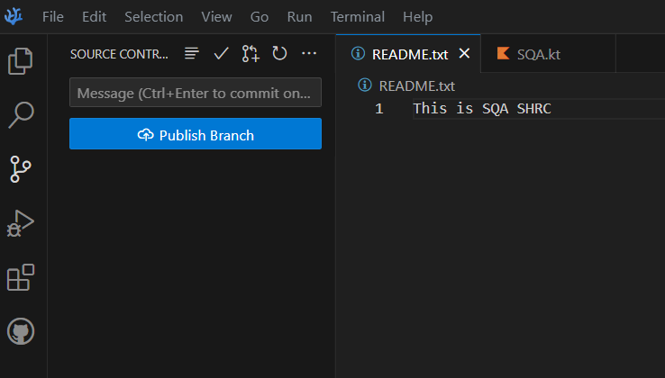
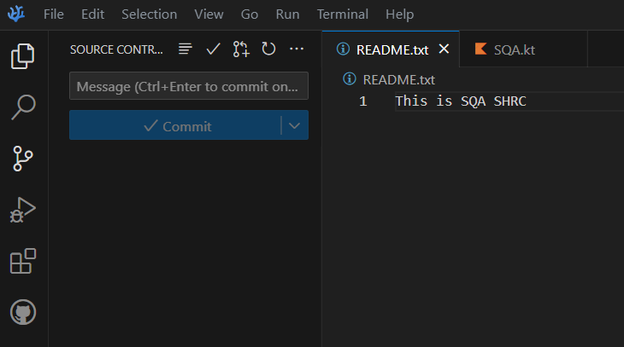
IV. Use VsCodium and Github
Click Yes
Click button ‘publish branch’ will be ask login github, just login

Slide 15
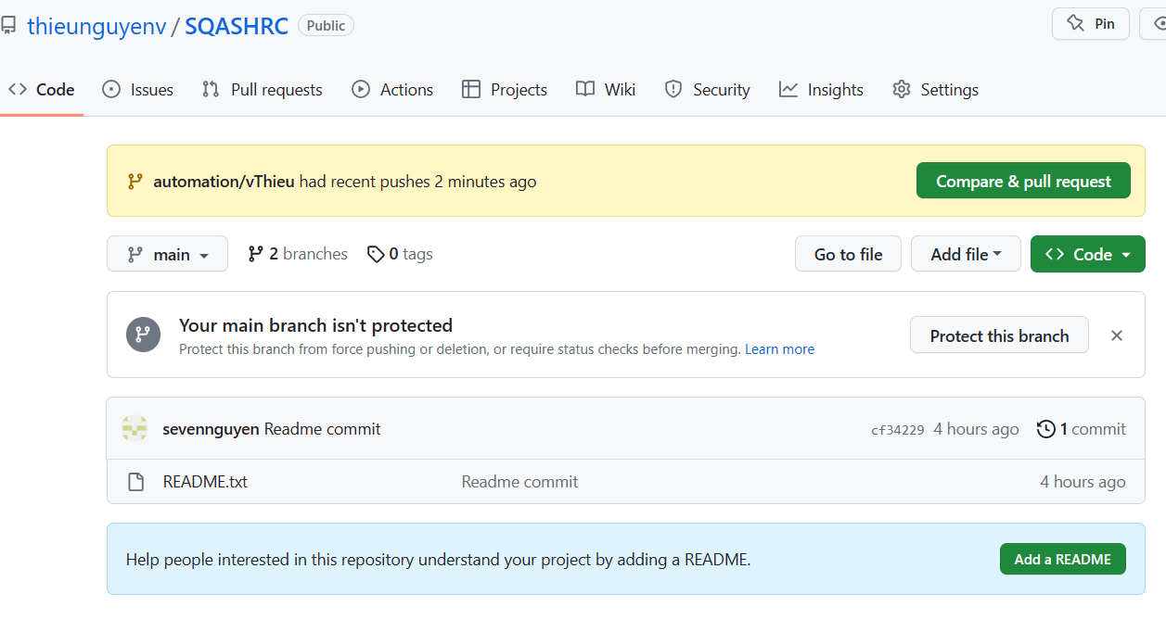
IV. Use VsCodium and Github
Click Yes
Click button ‘publish branch’ will be ask login github, just login
And create pull request on web browser

Slide 16
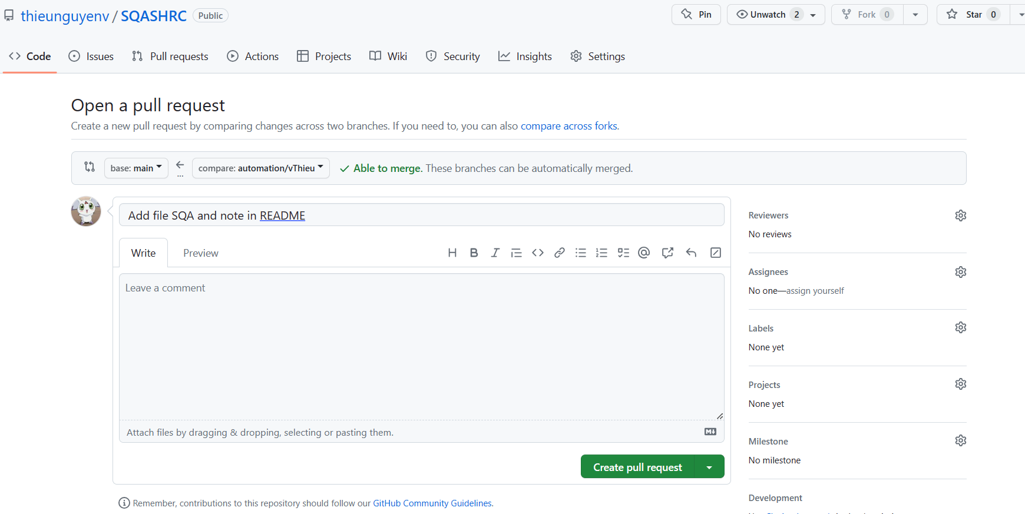
IV. Use VsCodium and Github
And create pull request on web browser
After add title and comment then click create pull request

Slide 17
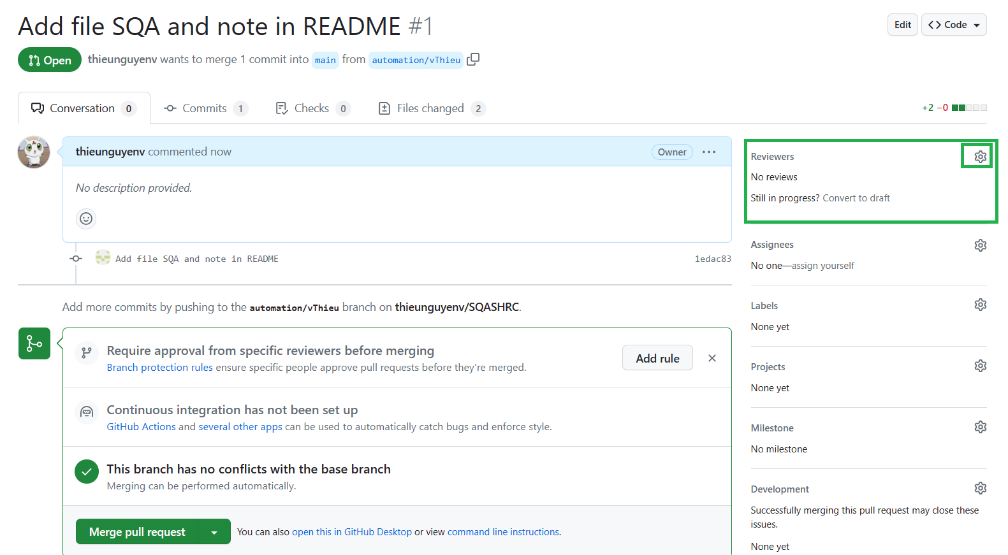
IV. Use VsCodium and Github
Before click ‘Merge pull request’
Add viewer if need

Slide 18
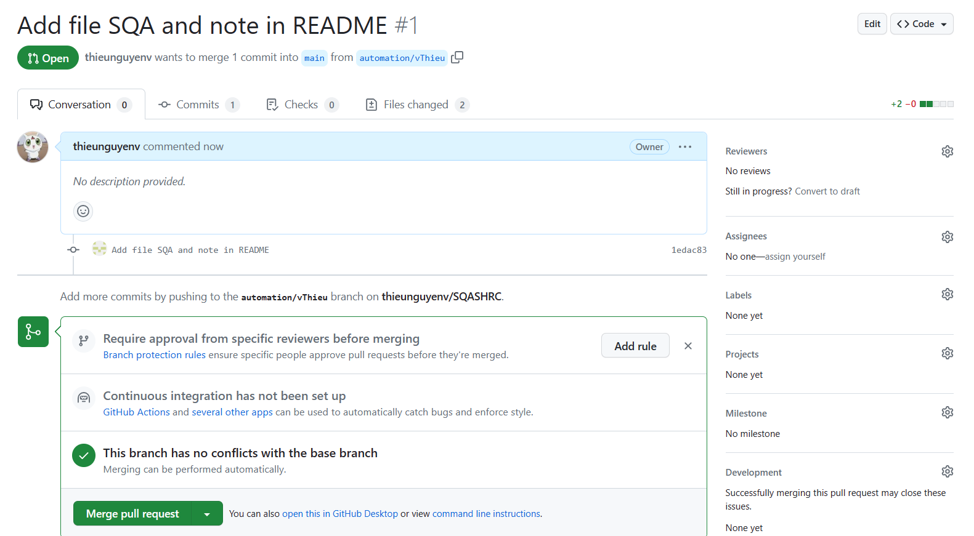
IV. Use VsCodium and Github
After click create pull request
If no conflict you can merge code by click ‘Merge pull request’ -> ‘Confirm merge’

Slide 19
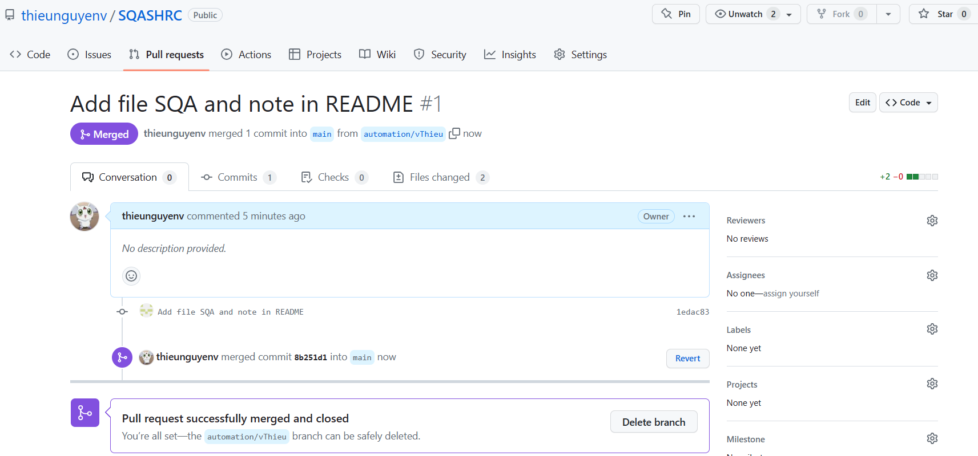
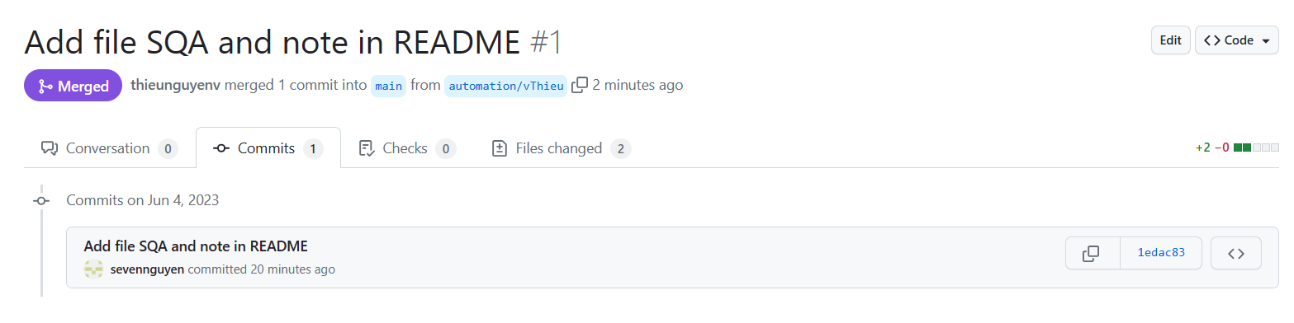
IV. Use VsCodium and Github
After ‘merge’ click tab commit show history you commited

Slide 20
IV. Use VsCodium and Github
Open VsCodium -> File -> open Folder where has project
After ‘merge’ click tab commit show history you commited

Slide 21
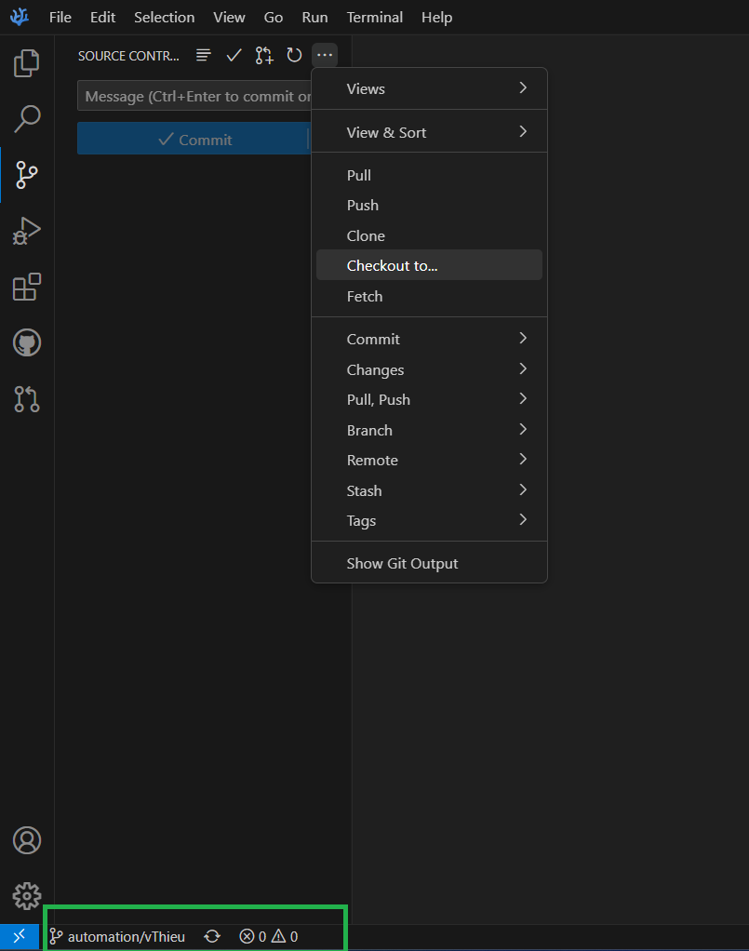
IV. Use VsCodium and Github
Update code into main branch
Click Checkout -> main
Or click automation/vThieu to change branch

Slide 22
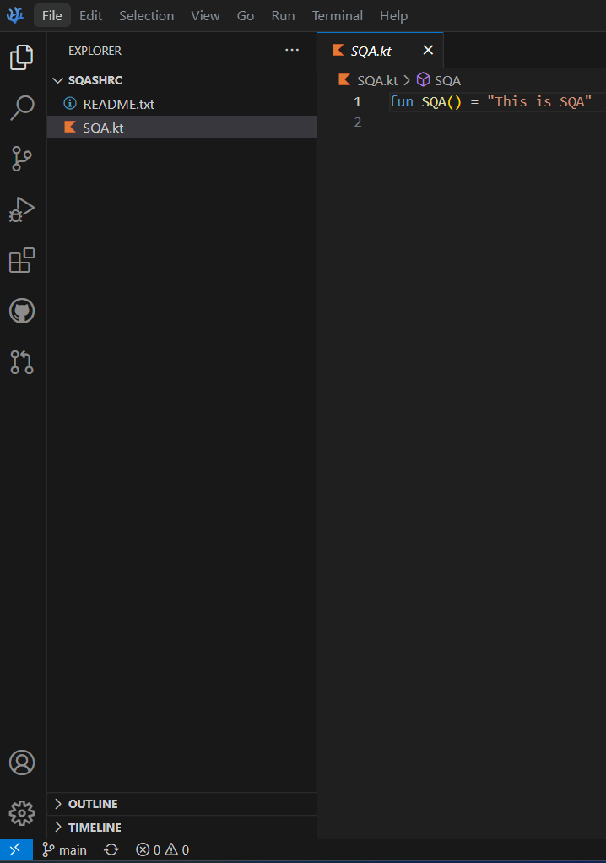
IV. Use VsCodium and Github
At main branch click Source Control -> Sync Changes to update project files

Slide 23
END

